Slide 1

Shop Billing System
(Computer Hardware Shop billing system)
A system that contains the menu of the shop and prsents the available items in the shop and then generates a bill

Slide 2

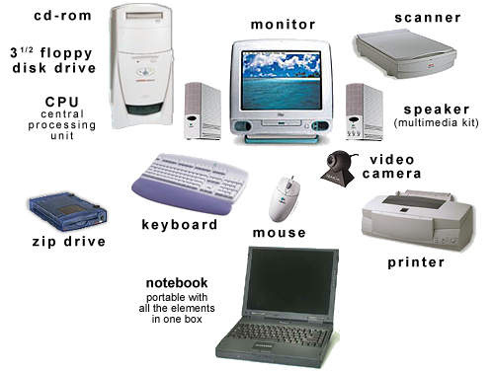

INTRODUCTION
I chose a computer Hardware shop. My this software will first display the available computer hardwares in the shop (User will be able to customize their PC according to their need) and later on will generate the bill with accurate effeciency which could be altered when done manually by human

Slide 3
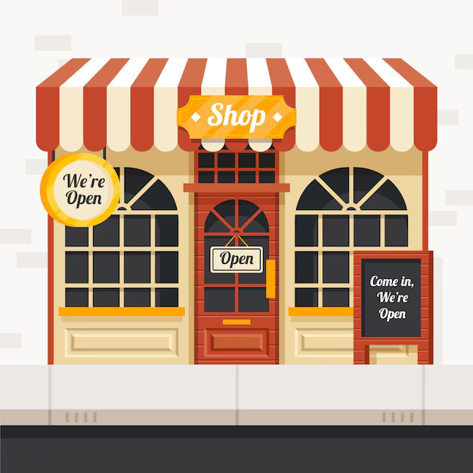
Objectives Of the project
Develop an automated billing system
Reduce calculation errors
Improve speed and efficiency
Store billing records safely
•Allow customizable PC component selection

Slide 4
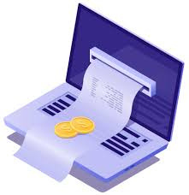
Why Billing is important ??
Billing is essential for businesses because it guarantees timely customer payments and supports steady cash flow.
It provides accurate records that build customer trust and aid financial tracking.
A proper billing system also helps analyze inventory and sales, strengthening overall business operations.

Slide 5
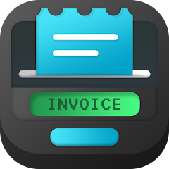

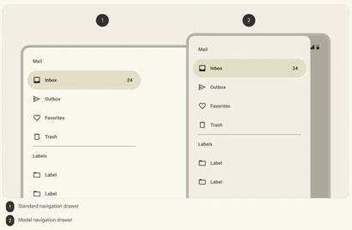
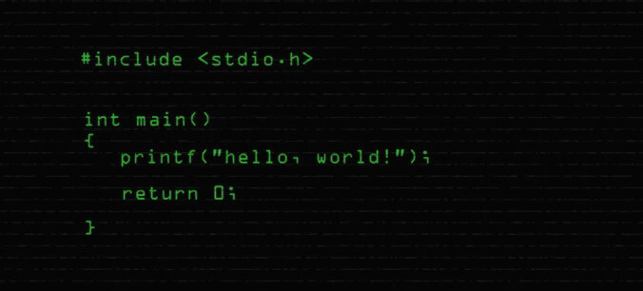

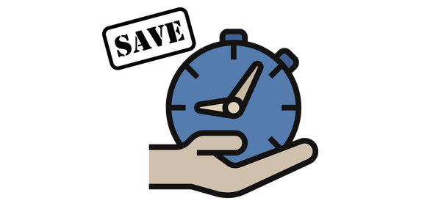
Features of this shop billing system
Quick billing System
Easy to operate
User-friendly and easy to operate
Automatic calculation of totals
Quick billing during rush hours
Error-free bill generation
Menu-based navigation
·Saves time and reduces workload
C-programming language is used for developing this system (Various elements like functions, switch case, loops and conditions have been used.
Menu-Based System
C-Programming
Error-Free
Saves time

Slide 6
Technology used
(Elements of C-programming used)
•Functions : To make the code readable and design modularity
•Loops and conditions
•Switch-case for menu design
. Small mathematical calculations
.Comments for readability
. Control Transfers statements like Goto, switch and continue.

Slide 7
Future Enhancement
Add GST and discount calculations
Generate PDF bills
GUI interface in the future
Database support
Monthly and weekly sales reports

Slide 8
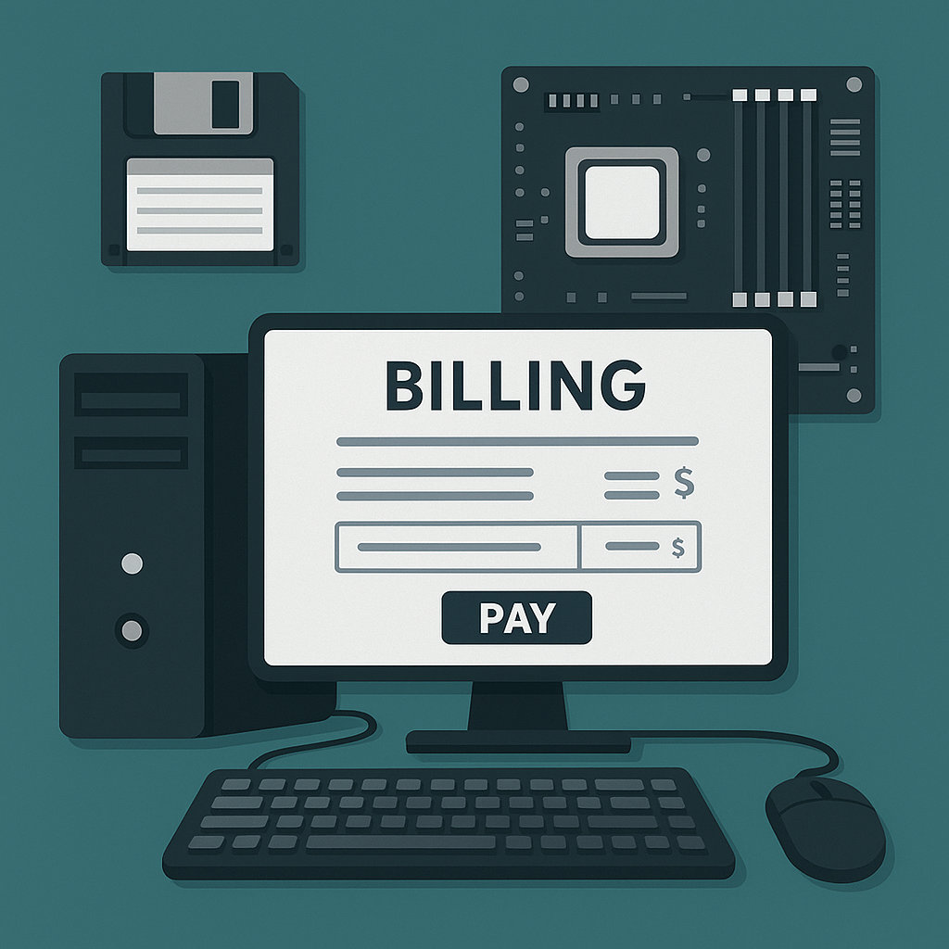
CONCLUSION
In conclusion, a shop billing system plays a vital role in any business because it ensures accurate billing, timely payments, and smooth financial management. In my project, the Computer Hardware Shop Billing System, I demonstrated how efficient billing improves customer trust and helps track sales, inventory, and daily transactions with ease.
To build this system, I applied key elements of C programming, including file handling for storing and retrieving bills, structures for organizing product and customer data, pointers for efficient data manipulation, loops and conditions for menu-driven operations, and functions to make the code modular and easy to maintain. Overall, this project highlights how C programming can be used to automate real-world business processes and create a reliable, user-friendly billing solution.

Slide 9
Thank You
NAME:ISHA VIJAY
SAP ID: 590027876
BATCH NO. :60

